Slide 1




Learnlytics
MAJOR PROJECT
AI-Powered Student Learning Behavior Analyzer with Predictive Modeling

Slide 2

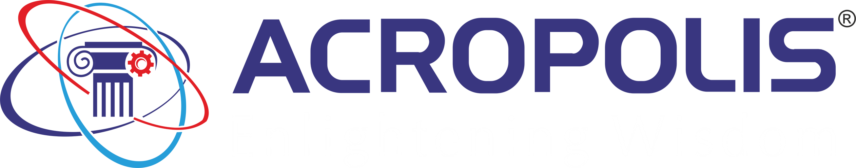

Enlightening Wisdom
ACROPOLIS INSTITUTE OF TECHNOLOGY AND RESEARCH, INDORE
MAJOR PROJECT
Department of CSE-DS

Slide 3


"Empowering education through data and AI, Learnlytics is not just about predicting outcomes -it's about unlocking each student's potential and guiding them towards success, one insight at a time."

Slide 4

Overview
❖ Abstract
❖ Introduction
❖ Problem Statement
❖ Survey of Existing Systems
❖ Project Objectives
❖ Requirement Analysis
❖ Solution Proposed
❖ The Outcome Discussion
❖ Limitations
❖ Conclusion
01
02
03
04
05
06
07
08
09
10

Slide 5


ABSTRACT
Learnlytics is an AI-powered system designed to track and analyze student learning behaviors using predictive modeling. The project enables real-time analysis of student progress, learning outcomes, and personalized recommendations. By integrating educational data mining and machine learning, Learnlytics aims to assist both students and educators in improving academic success.

Slide 6
INTRODUCTION
Modern education is increasingly driven by data, making it essential to track and analyze student learning behavior to improve academic outcomes. Learnlytics provides an AI-powered platform that enables students to submit progress reports, learning outcomes, and study plans. Administrators can monitor and analyze this data to uncover insights. Drawing from the principles of educational data mining, Learnlytics uses predictive modeling to help educators identify students in need of support.

Slide 7


Learnlytics
PROBLEM STATEMENT
Lack of scalable, automated systems to track real-time student behavior.
Existing systems don’t fully capture academic progress or allow timely interventions.
Learnlytics applies machine learning to fill these gaps and predict student success​
"AI for brighter academic futures."

Slide 8


Coursera
Provides learners with progress tracking on course completion rates and learning outcomes.
Lacks AI-driven personalized recommendations and predictive modeling.
SURVEY OF EXISTING SYSTEMS
Google Classroom Analytics
Tracks student engagement, assignment completion, and performance in real-time.
Lacks advanced machine learning models to predict student success.
Moodle Learning Analytics
Open-source platform with tools to track student activity and performance.
Limited predictive insights, primarily focusing on retrospective analysis.

Slide 9


PROJECT OBJECTIVES
The primary objective of the Learnlytics project is to leverage AI and data analytics to monitor, analyze, and predict student learning behavior, enabling both students and educators to make informed, data-driven decisions for improving academic success.
01
02
03
04
Objective 01
Objective 02
Objective 03
Objective 04
Track and analyze student progress via personalized dashboards.
Provide admins with tools for data-driven insights.
Deliver personalized learning feedback based on individual patterns.
Contribute to educational data mining research

Slide 10
REQUIREMENT
ANALYSIS

Slide 11

Student data input
(progress,certifications, results).
01
FUNCTIONAL
REQUIREMENTS
02
Admin analytics interface for monitoring trends and insights.
03
Predictive analytics for early intervention.

Slide 12
01
Scalability
NON- FUNCTIONAL
REQUIREMENTS
02
Data Security
03
High Prediction Accuracy

Slide 13


SOLUTION
PROPOSED
Student Dashboard
Admin Dashboard
Machine Learning
Tracks progress, receives feedback, updates study plans.
Analyzes student data, generates reports, predicts outcomes.
Decision Trees, Random Forest, Neural Networks to predict success and highlight students needing support

Slide 14
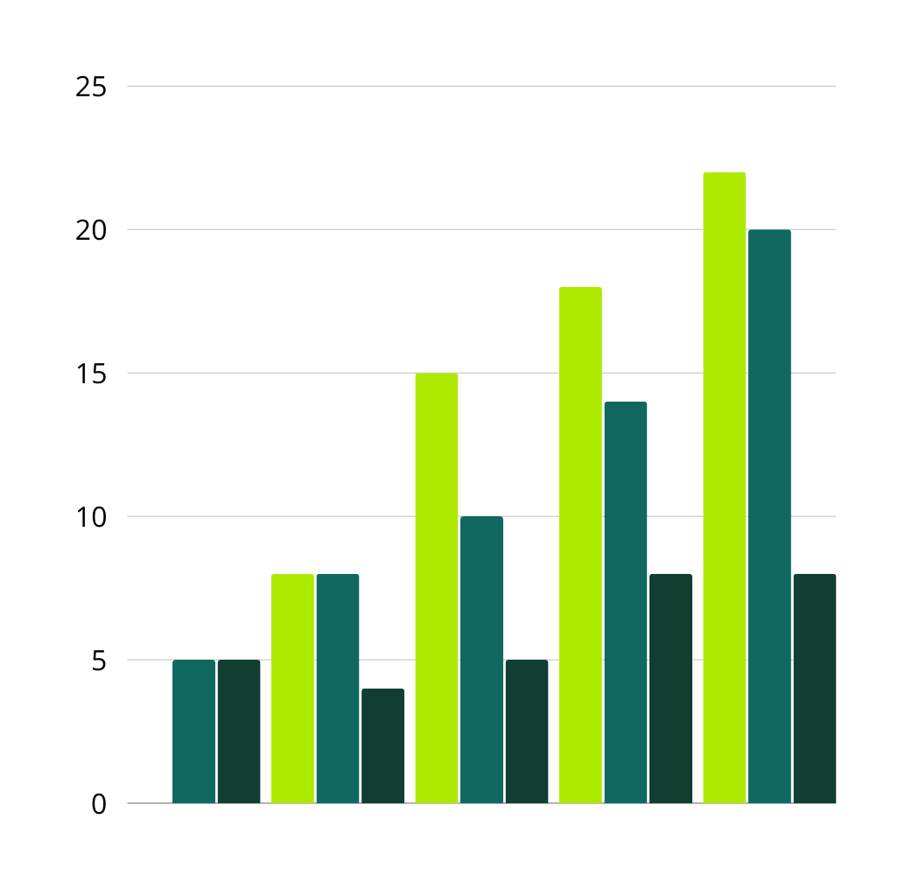
EXPECTED OUTCOMES
Student Outcomes
Personalized feedback and performance tracking.
Admin Outcomes
Data visualization, trend analysis, early warnings for students at risk.
Project Outcomes
Predictive modeling enhances support and decision-making

Slide 15







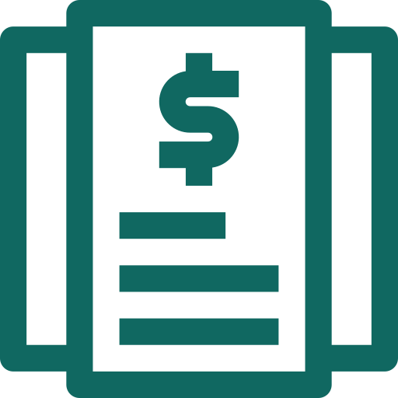

LIMITATIONS
Model Generalization
Real-Time Prediction
Maintenance
Integration
Data Dependency
Scalability
Ethical Concerns

Slide 16

CONCLUSION
The “Learnlytics: AI-Powered Student Learning Behavior Analyzer with Predictive Modeling” aims to bridge the gap between student progress tracking and data-driven insights. By developing this tool, we aim to make meaningful contributions to learning analytics and educational data mining while offering students and administrators valuable resources for enhancing academic performance.

Slide 17




TEAM MEMBERS
HIMANSHU SOPRA
NIDHI SHARMA
OSHIN NANDWAL
SURABHI JAISWAL
GUIDED BY:
PROF. BRAJESH CHATURVEDI

Slide 18

Learnlytics
THANK YOU

